Slide 1
Multi layer perceptron

Slide 2


Import packages

Slide 3


MNIST

Slide 4
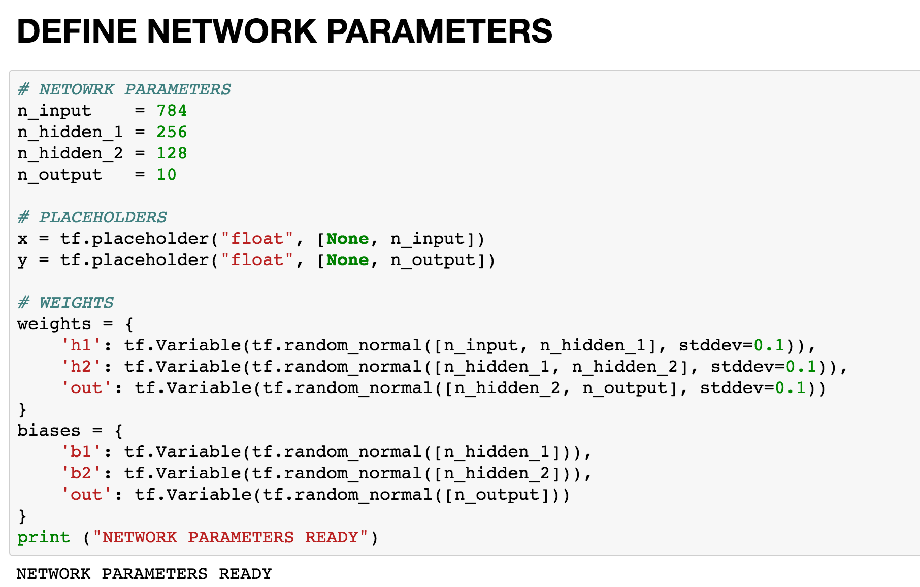
Tensor graph constructed

Slide 5
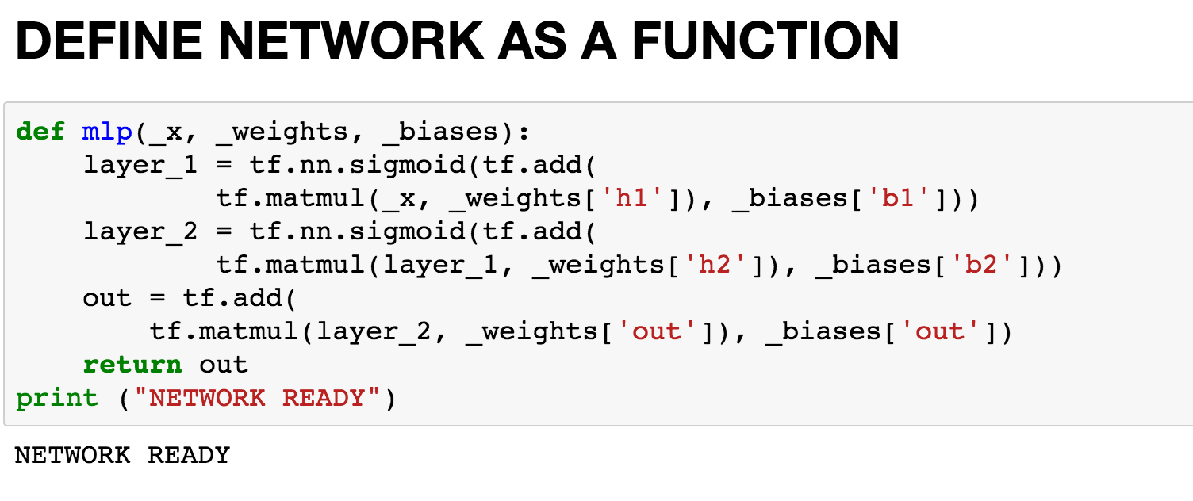
Functions

Slide 6
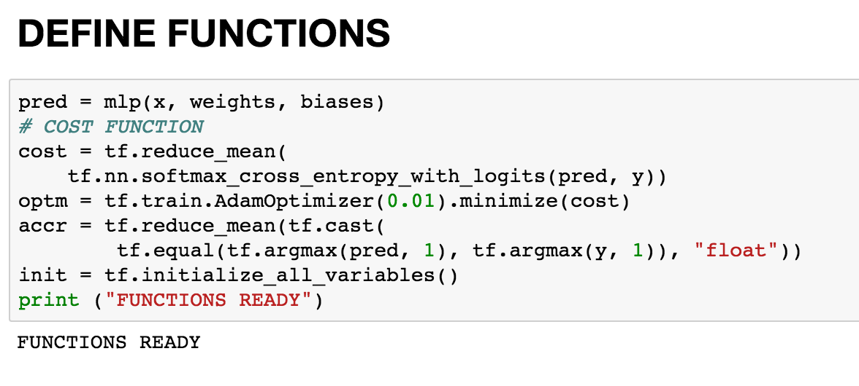
Functions

Slide 7
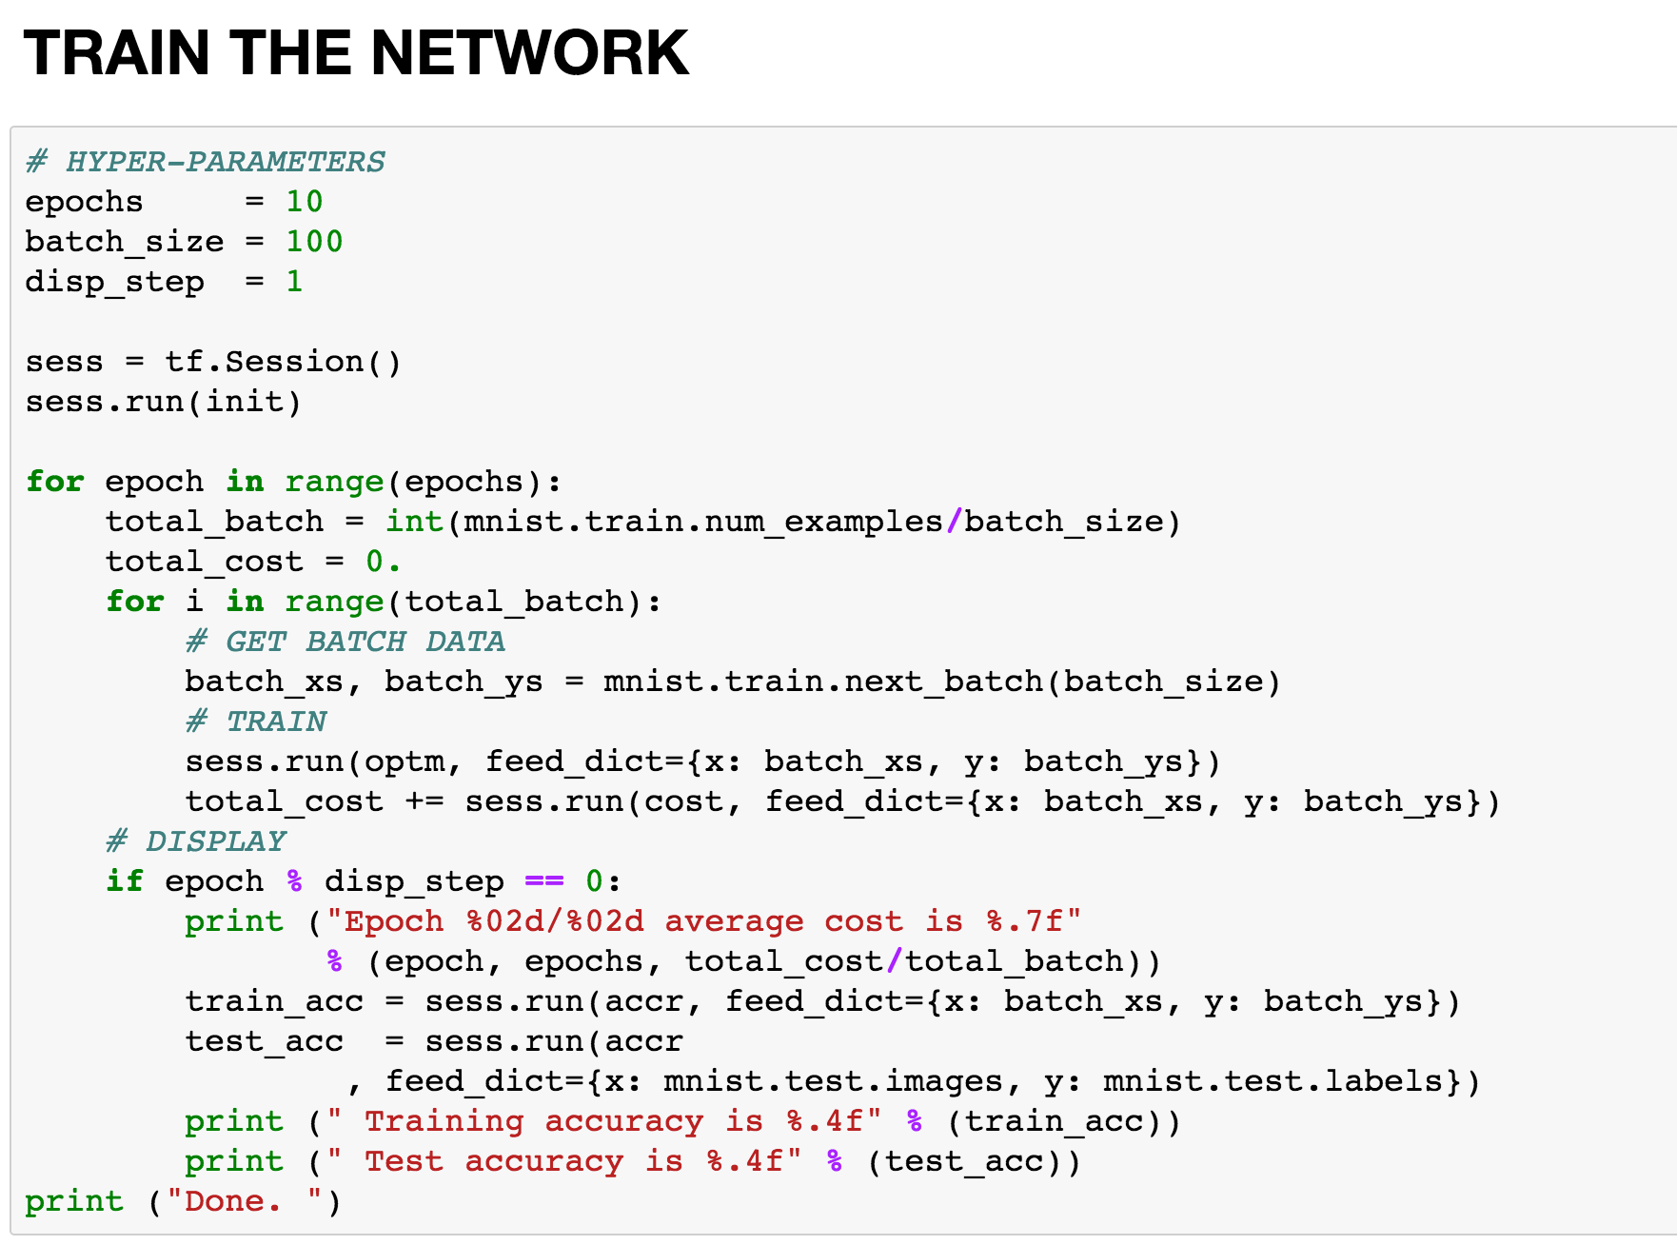
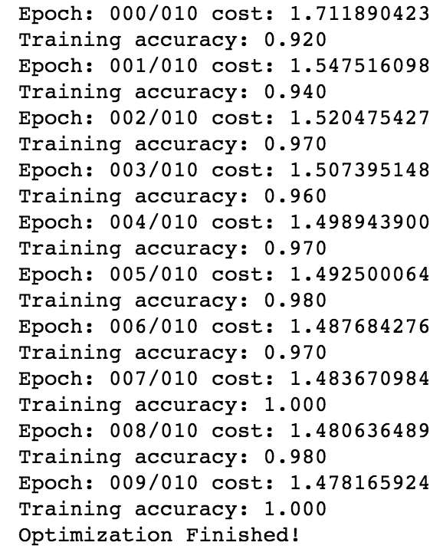
Run

Slide 8
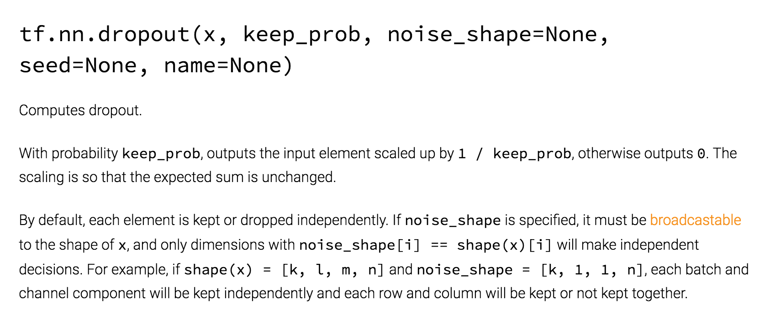
Further works
Add a third hidden layer!
Add dropout layers

